Slide 1


MANUFACTURING PERFORMANCE ANALYSIS FOR AXON LABELS
Data-Driven Decisions for Operational Excellence
PRESENTED BY: Group 1

Slide 2
GROUP DETAILS
 | GROUP - 1
1) | Tejaswini Chopade
2) | Mita Chongdar
3) | Alan Kujur
4) | Ashwini Lawande
5) | Varsha Borse
6) | Siva Bandala
7) | Bala Naidu
ROLE
All Members Actively Participate in every aspect of the Project Data Cleaning KPI Identification Excel, Tableau and PowerBI Dashboard creation SQL Queries and data Transformation Analysis and business insights

Slide 3
PROJECT OVERVIEW
Business Challenge : Axon Needed a system to track production efficiency and rejection trends
Our Approach :
a) Identify Key KPIs (Production, Rejection, Wastage, Employee/
Machine- wise analysis)
b) Build Dashboard (Excel Tableau Power BI) for Increasing
depth of insights
c) Use SQL queries to clean & Transform raw manufacturing data
3) Expected Outcome :
a) Detect Problem area (Employees, Machines, Departments)
b) Reduce wastage & rejection rates
c) Enable management to make data – driven decision

Slide 4




TOOL USED
MySQL - For Sorting, querying, and extracting structural labels data
Excel - For Data cleaning, Transformation, and KPI calculation
Power BI - For Interactive dashboard, drill down, and Trend analysis
Tableau - For Advanced data storytelling and Visual Insights

Slide 5
KPI LIST AND BUSINESS RELEVANCE
 | KPI List | Business Relevance
1) | Manufacture Quantity (Output) | Tracks Overall Production Volume and efficiency
2) | Rejected Quantity (Quality Control) | Identifies Defective Units, helps improve quantity standards
3) | Processed Quantity(workflow progress) | Shows stage-wise completion; useful for process optimization
4) | Wastage Quantity(Resource Utilization) | Monitors material loss: key for cost reduction and sustainability
5) | Employee - wise Rejected Quantity | Pinpoints training needs and improves individual performance

Slide 6
 | KPI List | Business Relevance
6) | Machine-wise Rejected Quantity (Equipment Efficiency) | Detects underperforming machines; helps with maintenance planning
7) | Production Comparison Trends (Performance Over Time) | Identifies growth patterns, seasonality, and productivity changes
8) | Machine vs Rejected (Quantity Ratio) | Direct Measure of Production Effectiveness and Rejection percentage
9) | Department –Wise Manufacture vs Rejected( process optimization) | Reveals department-specific issues to improve operations

Slide 7
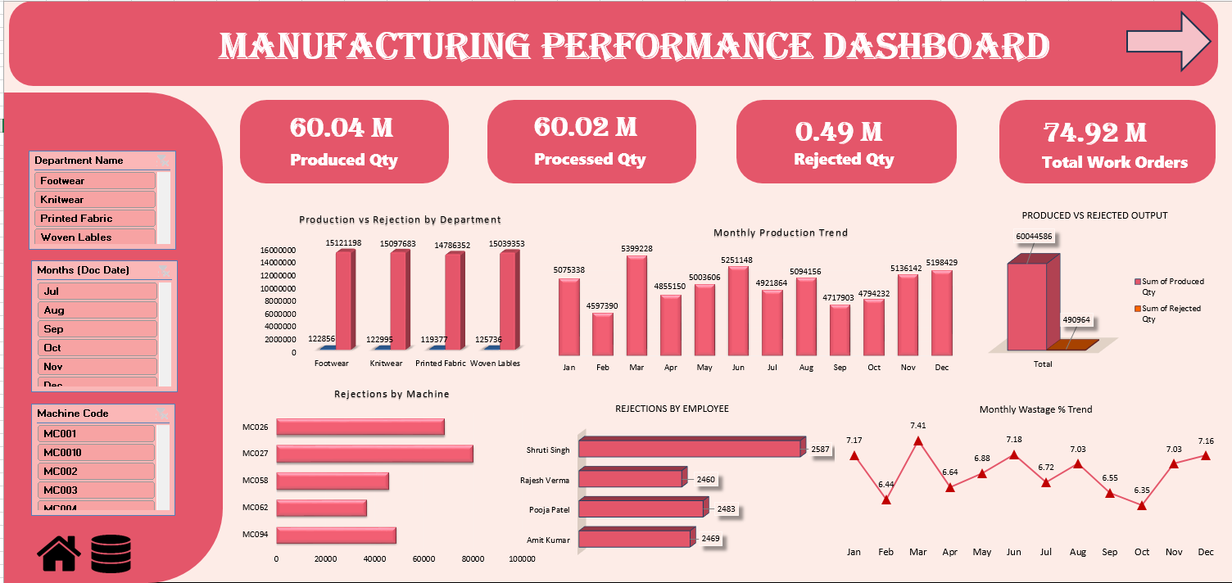
EXCEL DASHBOARD

Slide 8
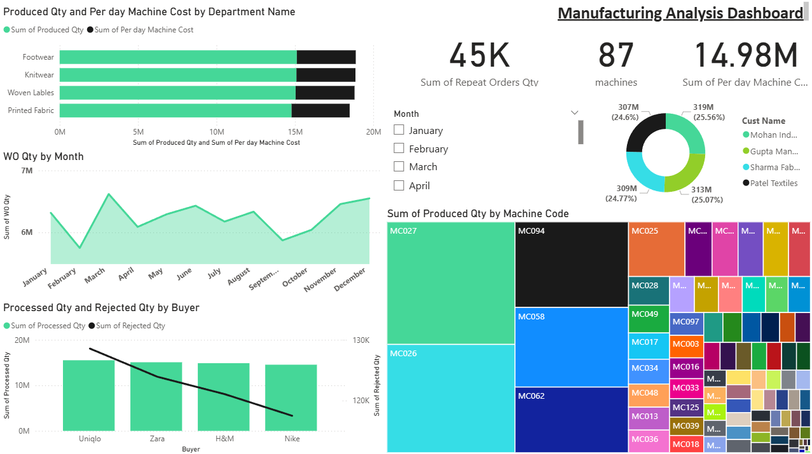
POWER BI DASHBOARD

Slide 9
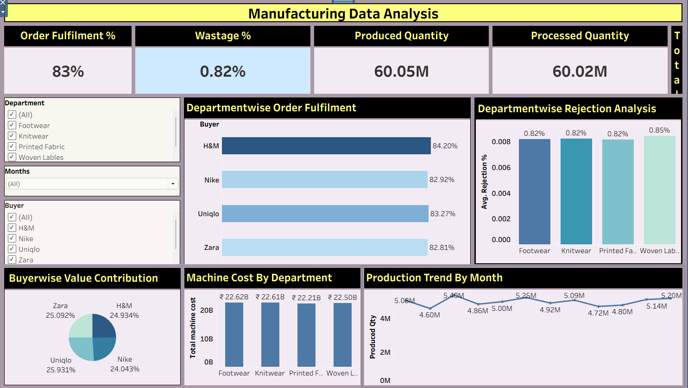
TABLEAU DASHBOARD

Slide 10

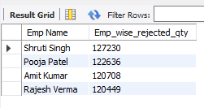

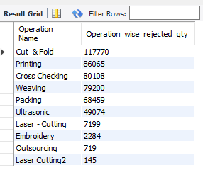

SQL QUERIES
Total quantity of items produced within a given timeframe.
Rejection count attributed to individual employees for accountability and training.
Number of units that failed quality checks and were rejected.
Tracks machine-specific rejections to identify underperforming equipment.
Materials or items lost during the production process.

Slide 11
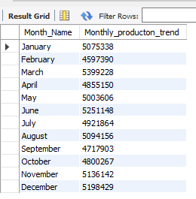
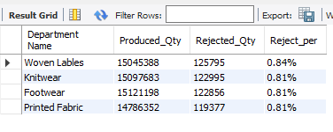

Visual trends of production over time to analyze performance patterns.
Department-level breakdown of production versus rejection to identify area-specific issues.
Direct comparison of produced and rejected quantities to assess quality ratios

Slide 12

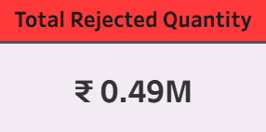
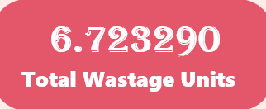
INSIGHTS FROM ANALYSIS
Total Production (Manufactured Qty)~ ₹4.6M – ₹5.4M per month (stable output)
Rejected Qty (Total Loss)~ ₹0.49M worth of rejected items
Wastage % (Process Inefficiency)Avg. 6–7% per month

Slide 13
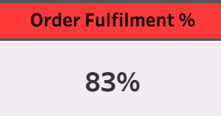
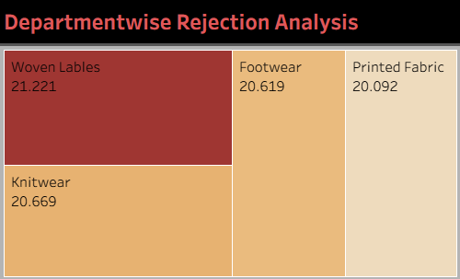
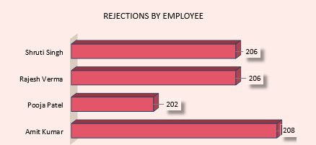
Order Fulfilment 83% achieved (below standard ~95%)
Highest Department Rejections by Woven Labels ~21.221%
Employee with Highest Rejections Amit Kumar 208 units rejected

Slide 14
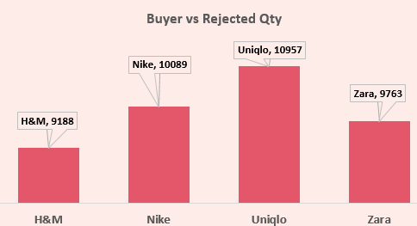
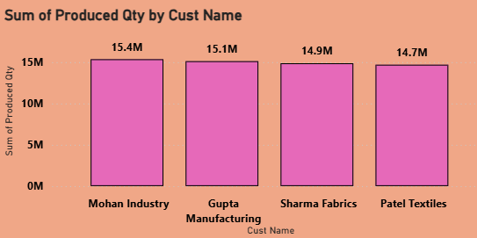
Buyer with Highest Rejections Uniqlo –10957 Rejections
Customer with Highest Production is Mohan Industry (15.4M) & Customer with Lowest Production is Patel Textiles (14.7M)

Slide 15
BUSINESS IMPACT
Data-Driven Decisions: Management can act on real production insights.
Quality Improvement: High-rejection departments identified for training.
Cost Efficiency: Wastage tracking reduces material loss.
Operational Efficiency: Bottlenecks in production are visible for optimization.
Accountability: Employee- and machine-wise tracking ensures responsibility.
Client Satisfaction: Timely, high-quality labels improve brand trust.

Slide 16


RECOMMENDATION AND FUTURE SCOPE
Regular KPI Monitoring : Use dashboards continuously to track production, rejection, and wastage
Prevention Maintenance: Schedule maintenance for machines with high rejection history to reduce downtime
Employee Training Programs: Focus on areas highlighted by employee-wise rejection data
Process optimization: Re- engineer workflows in departments with high defect rates
Predictive analysis: Extend dashboards to forecast production trends, predict high-rejection periods and prepare corrective action in advance

Slide 17
SUMMARY
Successfully analyzed Axon Labels’ production data using Excel, Tableau, and Power BI.
Built dashboards to monitor key KPIs: production quantity, rejections, wastage, employee/machine performance.
Provided actionable insights for improving quality, reducing wastage, and optimizing operations.
Enabled management to make data-driven decisions and plan preventive actions.
Dashboard framework can be extended for predictive analysis and real-time monitoring in the future.

Slide 18
THANK YOU

